Slide 1
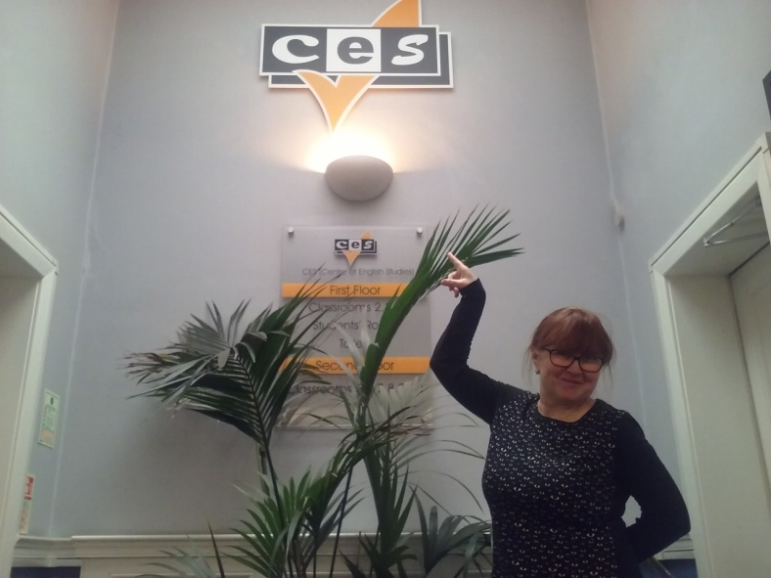
MOBILNOŚĆ KADRY EDUKACJI SZKOLNEJ
INTERNATIONAL HIGH FIVE
FOR TEACHERS:
together for innovations
*******
Biology and Landscape architecture teacher
in England

Slide 2
My English class
Intercultural education
Students from Brazil, Turkey, Saudi Arabia, Bahrain and Poland
Lifelong learning

Slide 3
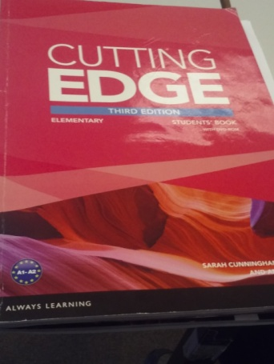
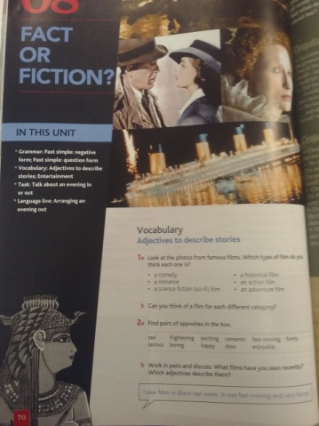
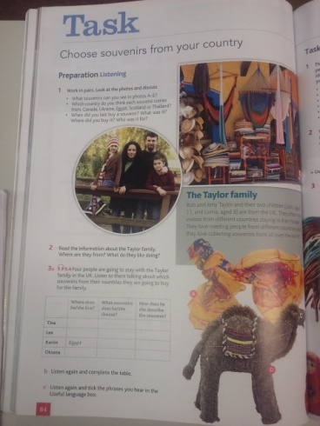
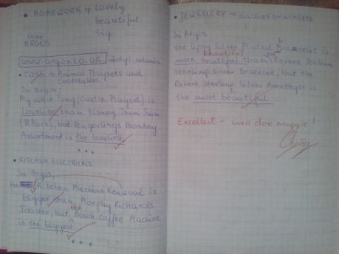
My English teachers
Chris
Inda
My book and my homework

Slide 4
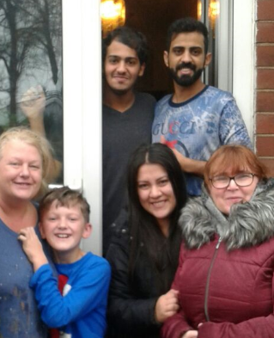
My English family
Jasmin and James Students from Colombia and Dubai

Slide 5
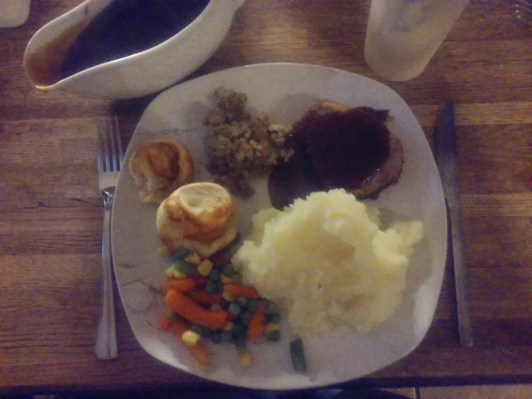
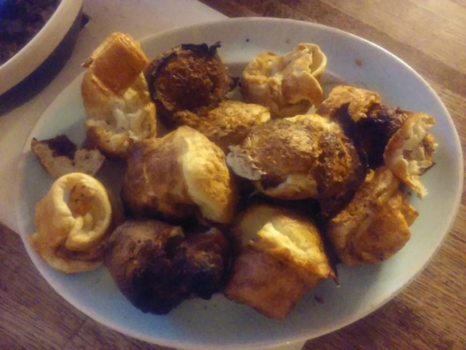
My English dinner
Sunday roast
Yorkshire pudding

Slide 6
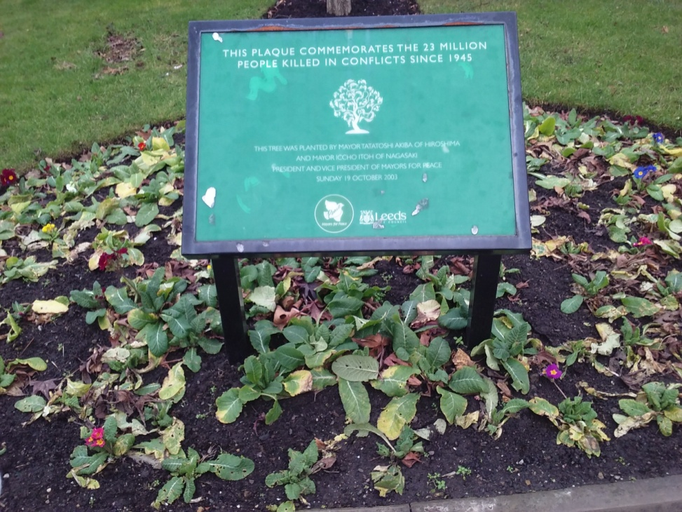
BIOLOGY: my job – my hobby
The English lawn often takes up a lot of space
in the garden and is its showcase

Slide 7
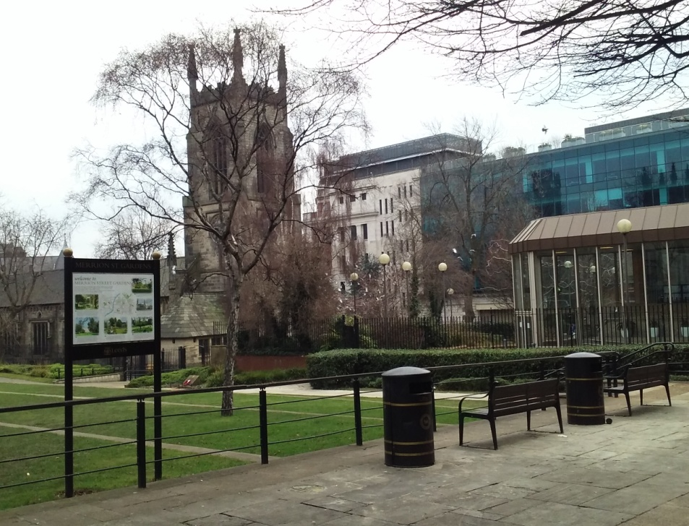
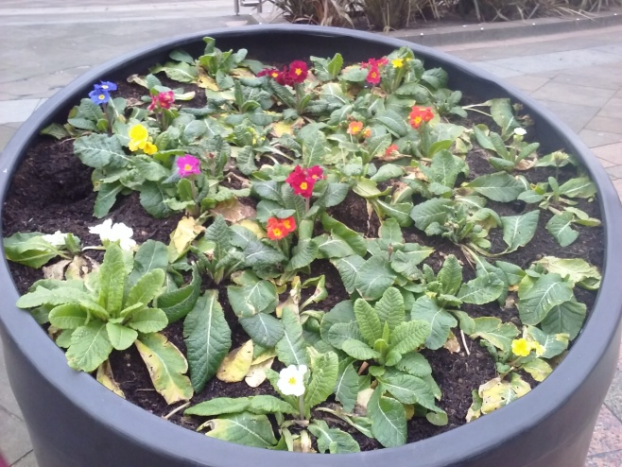
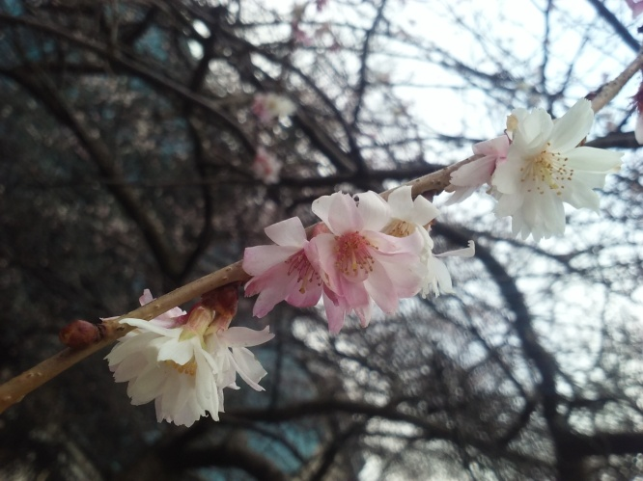
BIOLOGY: my job – my hobby
SPRING
on the street
in the garden

Slide 8
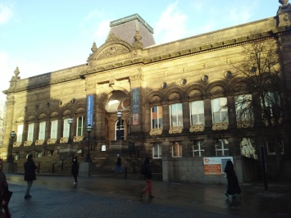
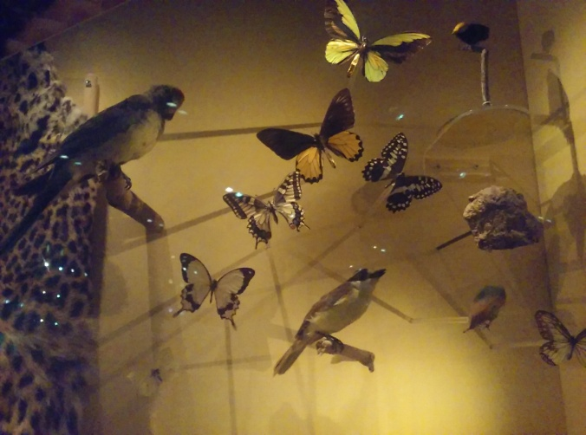
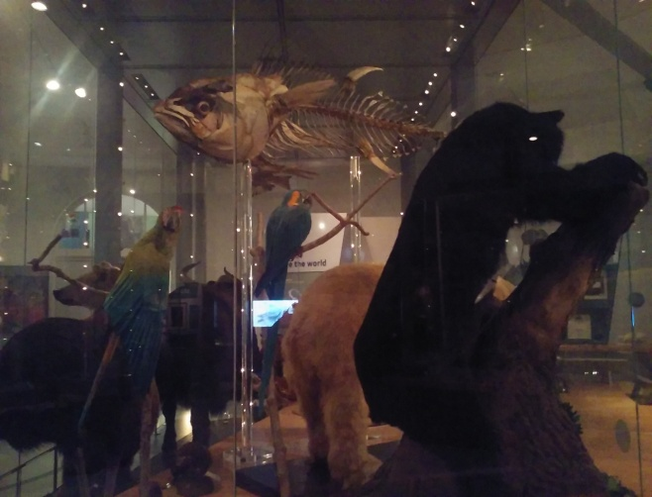
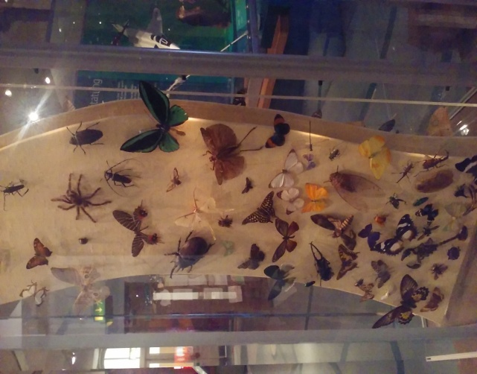
Visit Leeds City Museum
In Europe 10 000 years ago
Interesting exhibitions

Slide 9
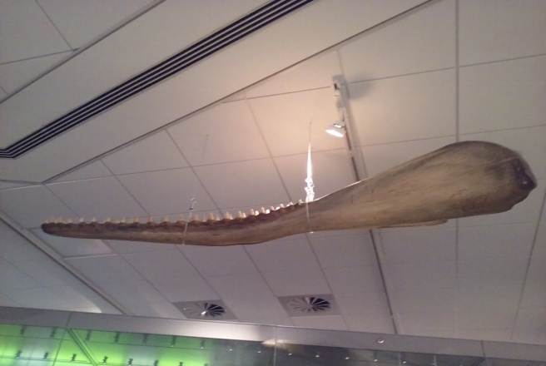
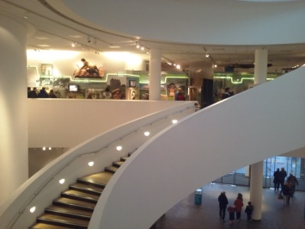
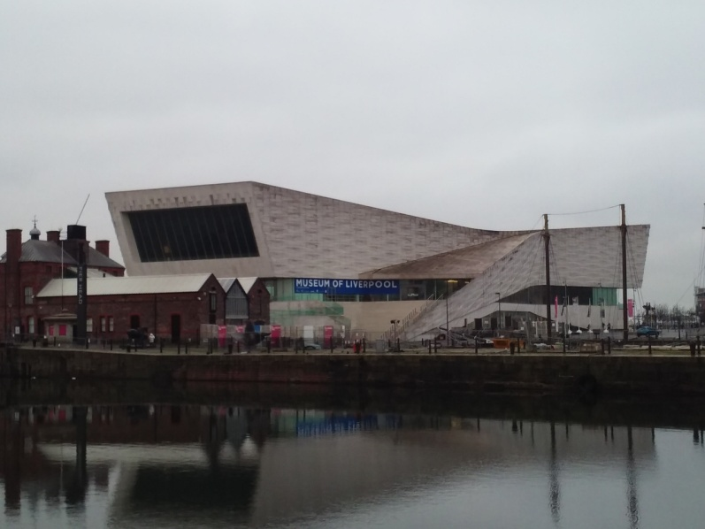
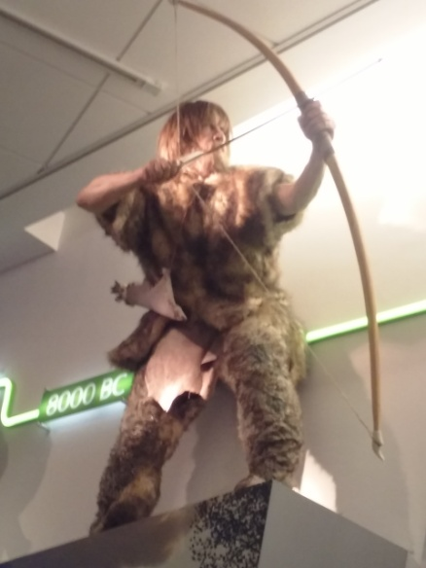
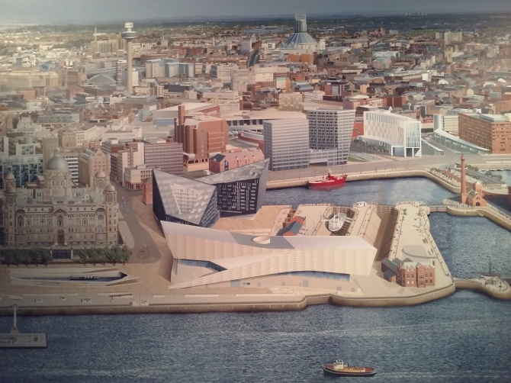
Visit Liverpool Museum
A lot of exhibits in a modern building

Slide 10
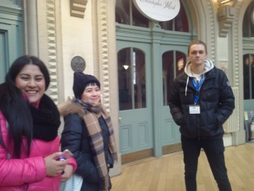
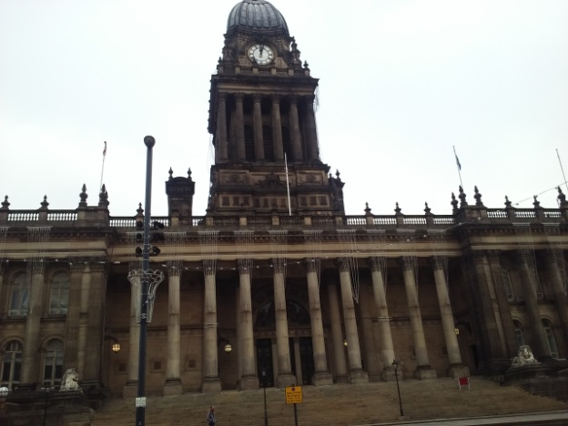
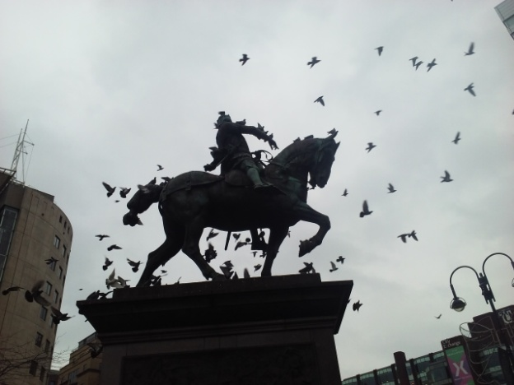
Beautiful architecture
Leeds Corn Exchange
Meeting places for people and pigeons
Town Hall

Slide 11
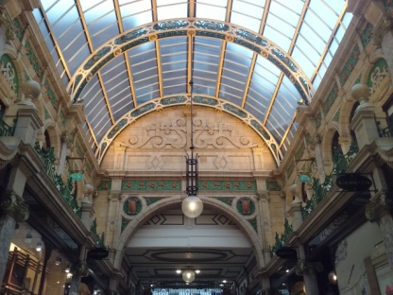
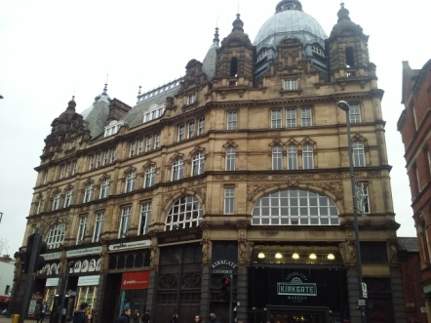
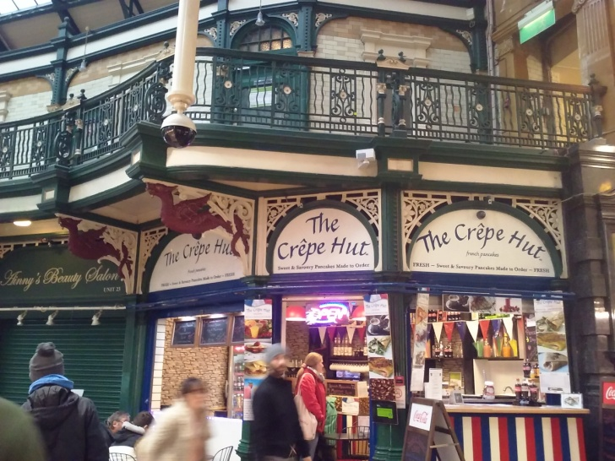
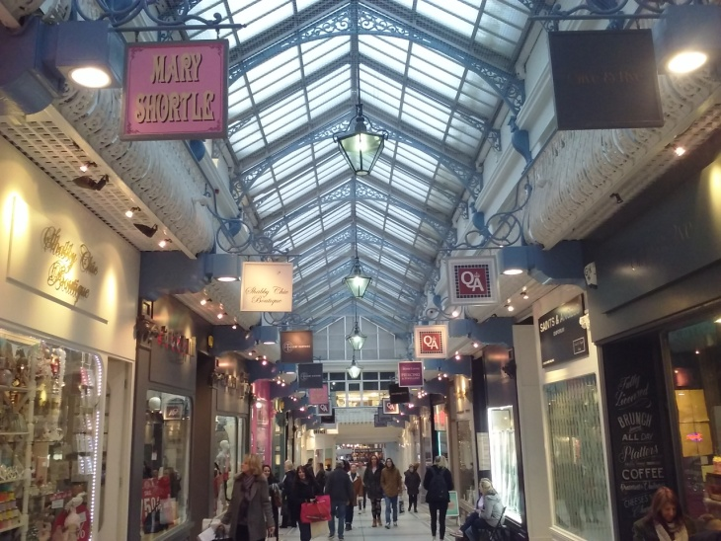
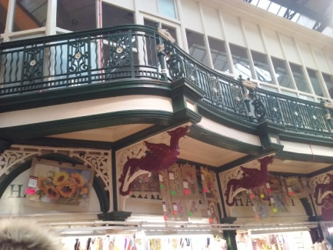
Beautiful architecture
County Arcade
Thornton’s Arcade
Kirkgate Market

Slide 12
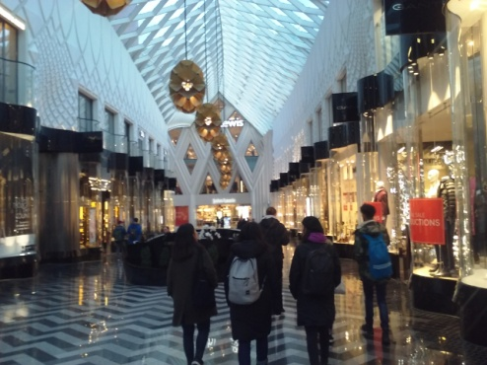
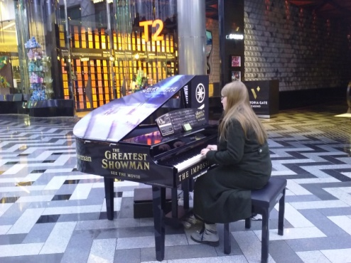
Beautiful architecture
Modern ceiling
and traditional floor
VICTORIA Leeds

Slide 13
Centre of English Studies (CES) Leeds, England 15 – 26 January 2018
THANK YOU ALL VERY MUCH
nice people
nice time
It was an amazing experience

